Slide 1



Slide 2
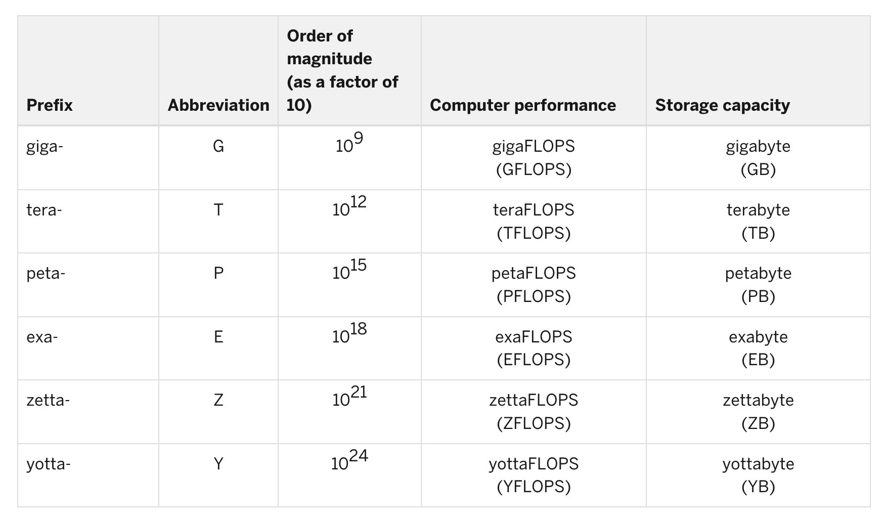
Measures of Computing Power
FLOPS: The number of floating-point arithmetic calculations systems can perform on a per-second basis.

Slide 3
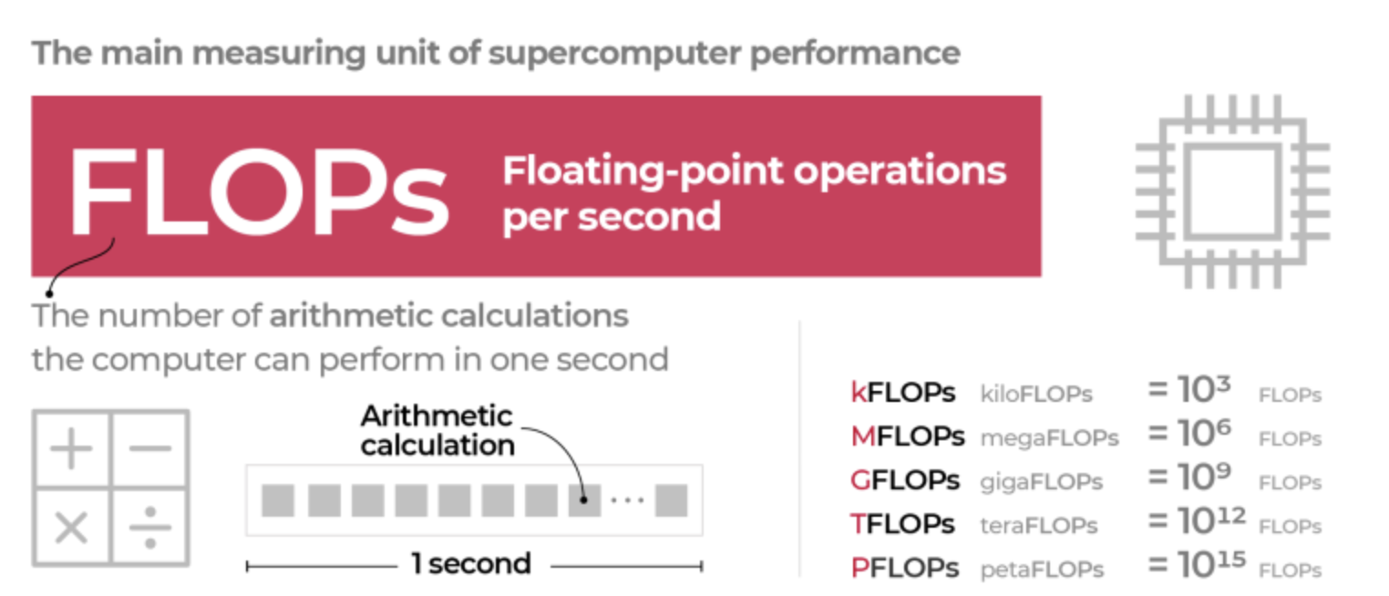

Slide 4
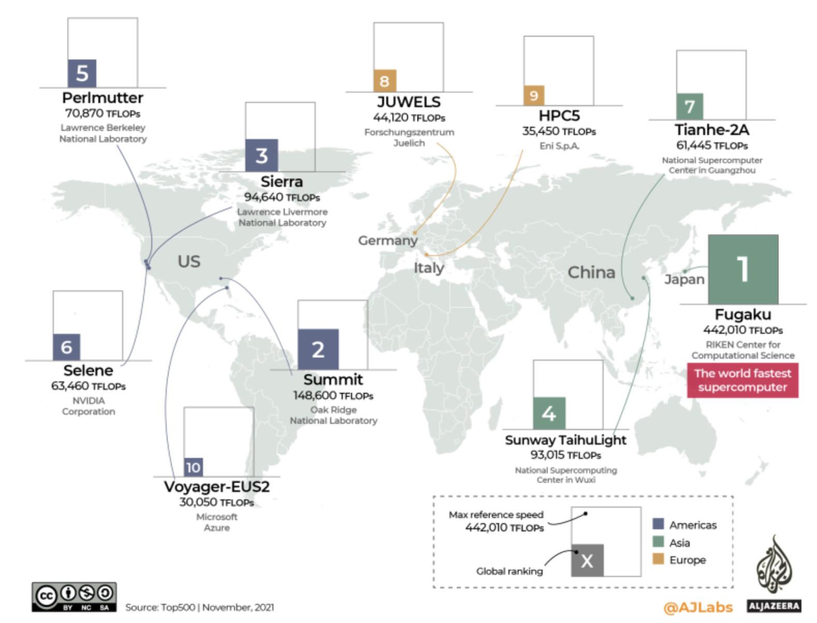

*
*
Most Recent: https://en.wikipedia.org/wiki/TOP500
https://www.aljazeera.com/news/2022/1/14/infographic-visualising-race-build-world-fastest-supercomputers-interactive#:~:text=According%20to%20Top500%2C%20which%20ranks,is%20the%20world's%20fastest%20supercomputer.

Slide 5
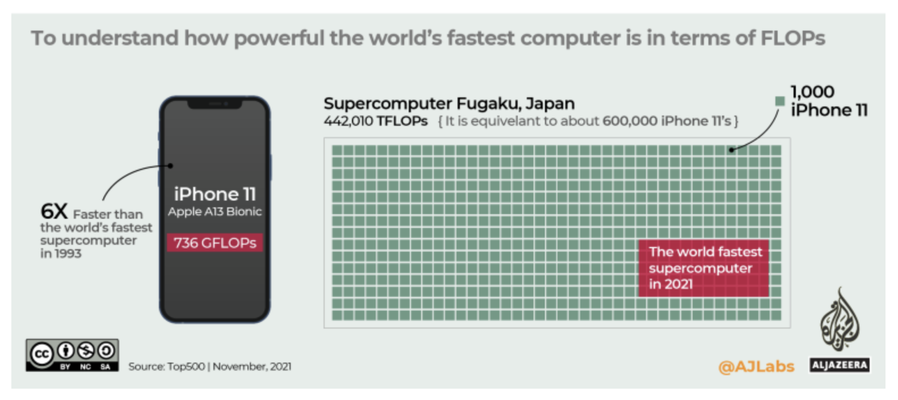

Slide 6
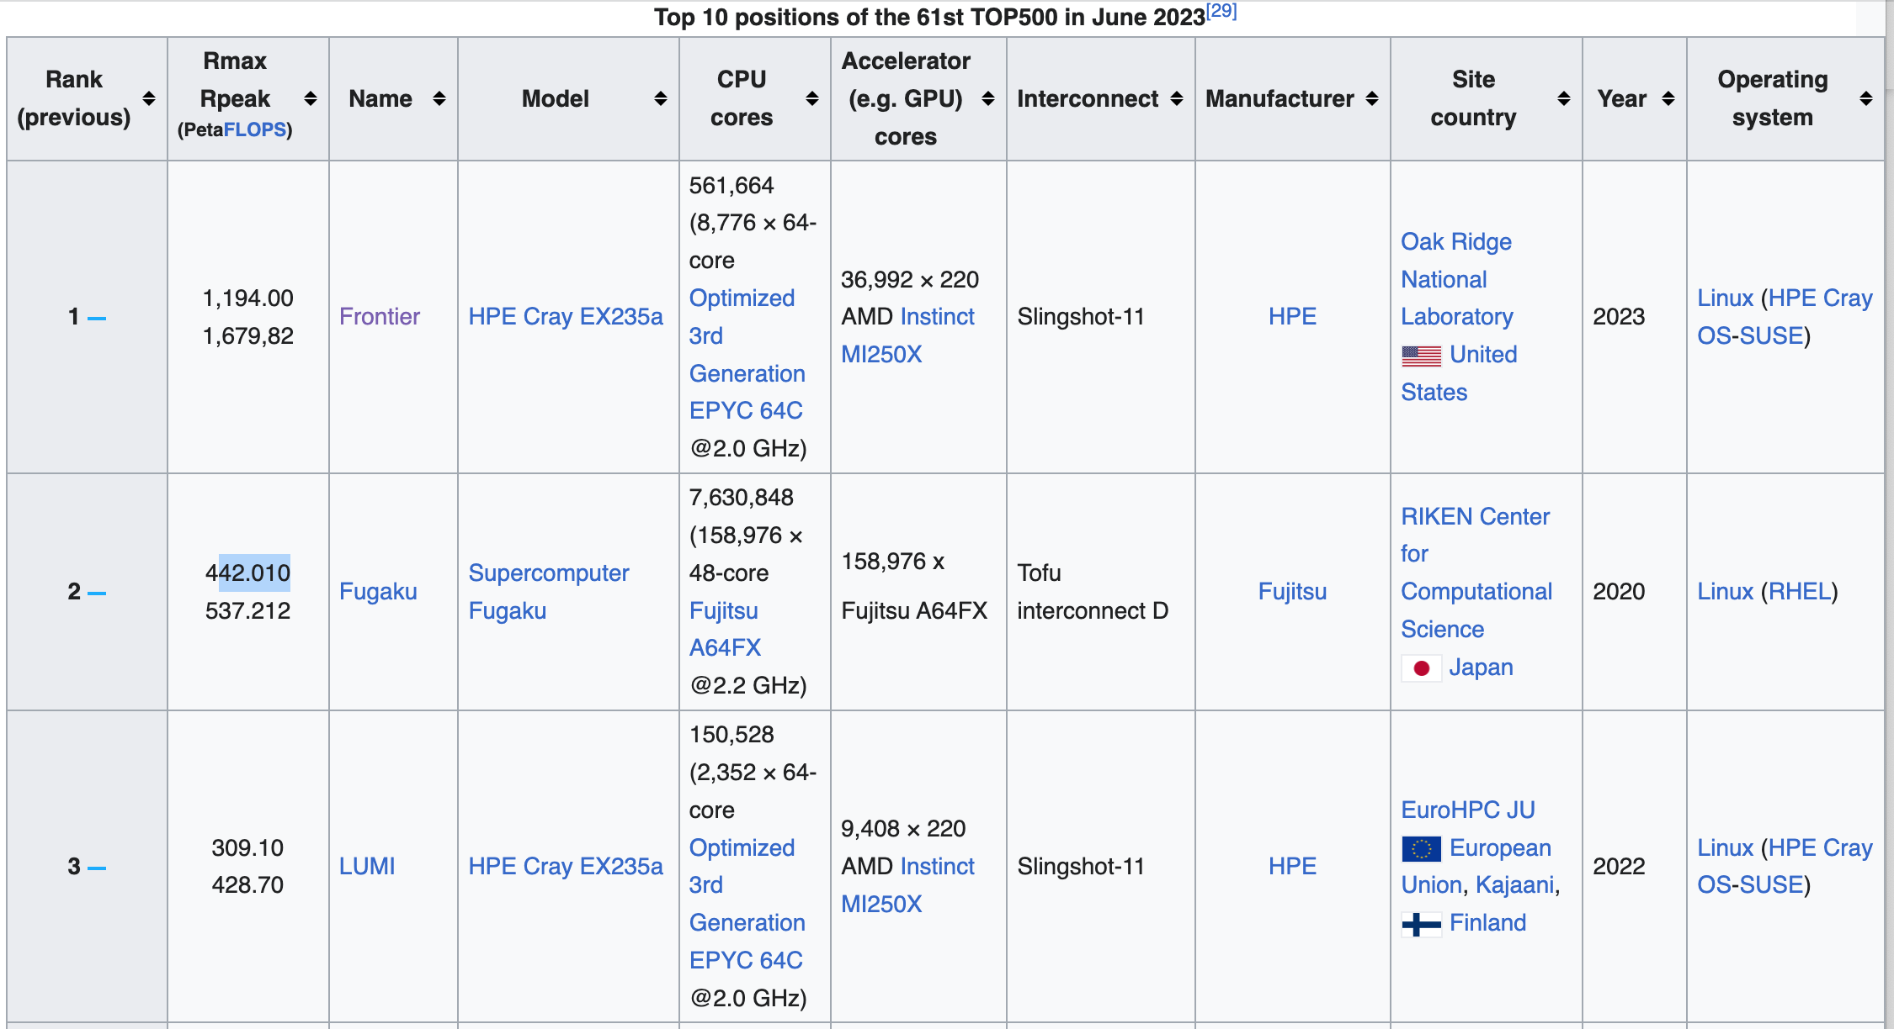
Most Recent: https://en.wikipedia.org/wiki/TOP500

Slide 7
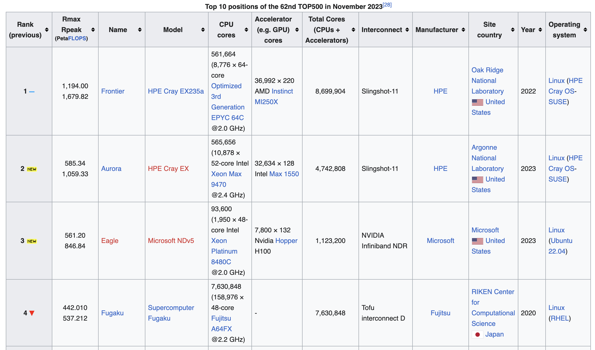

Slide 8
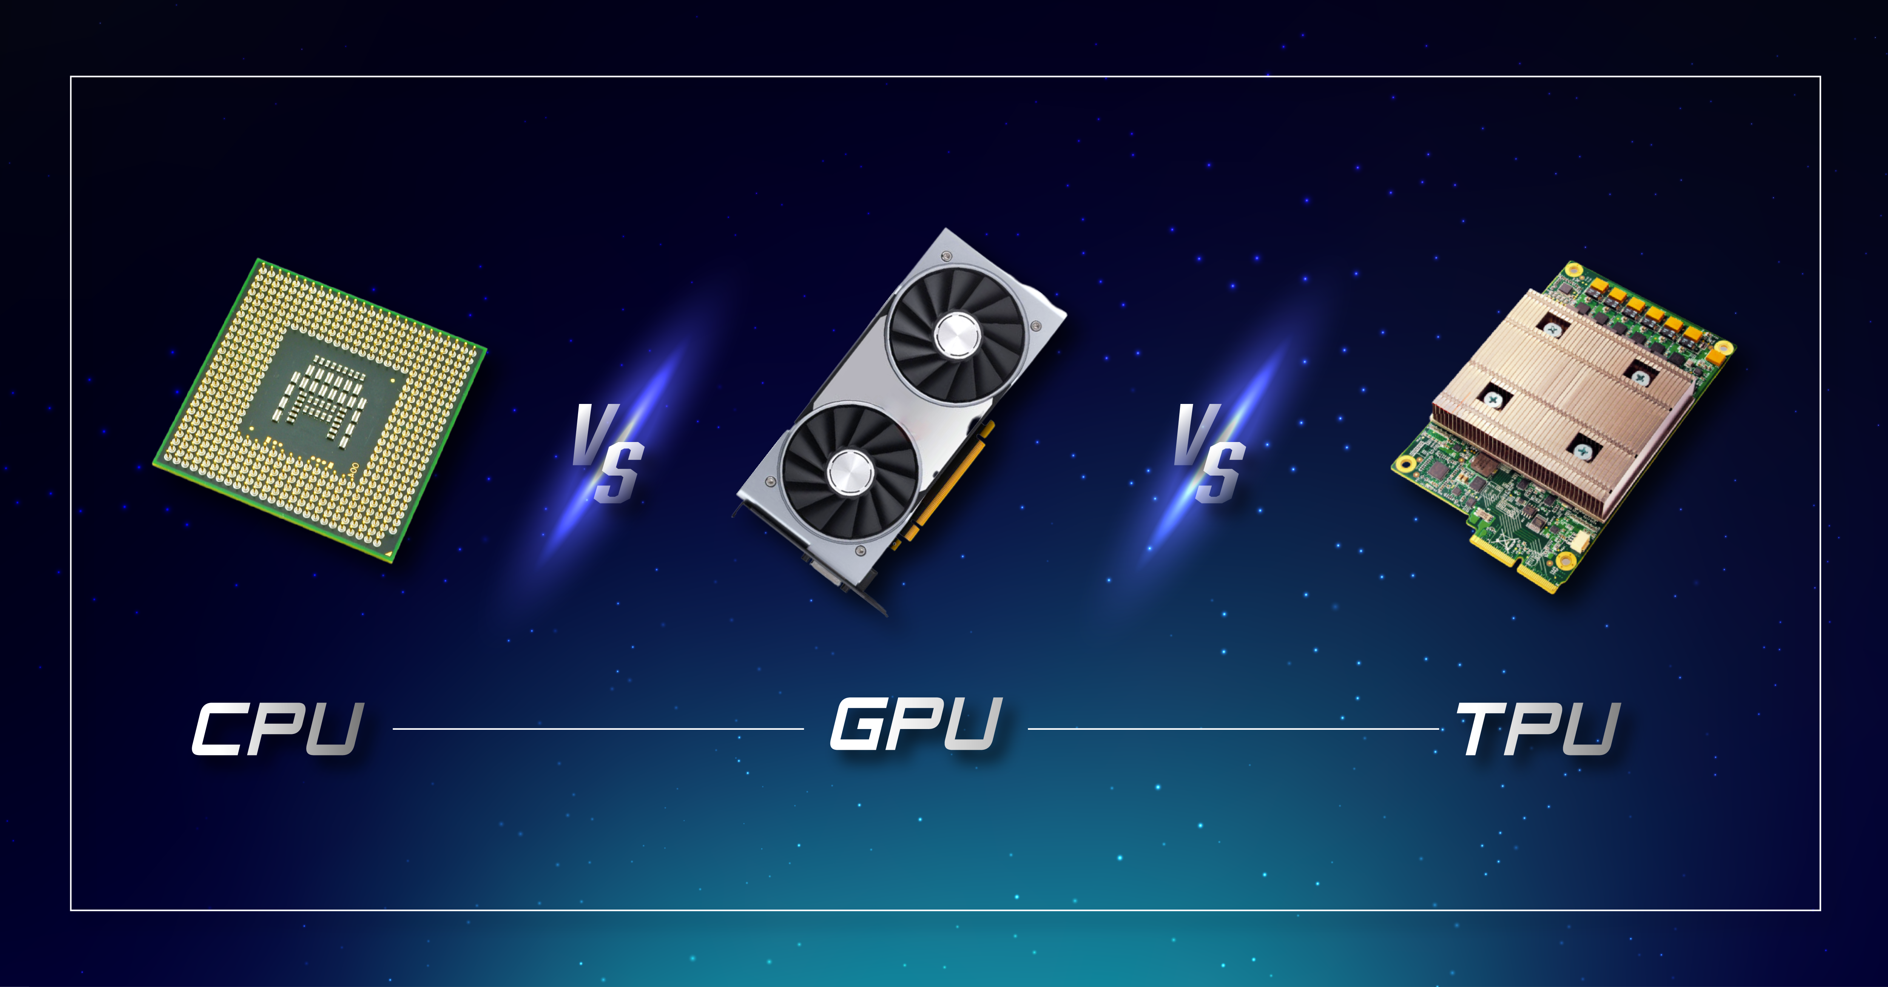

Slide 10
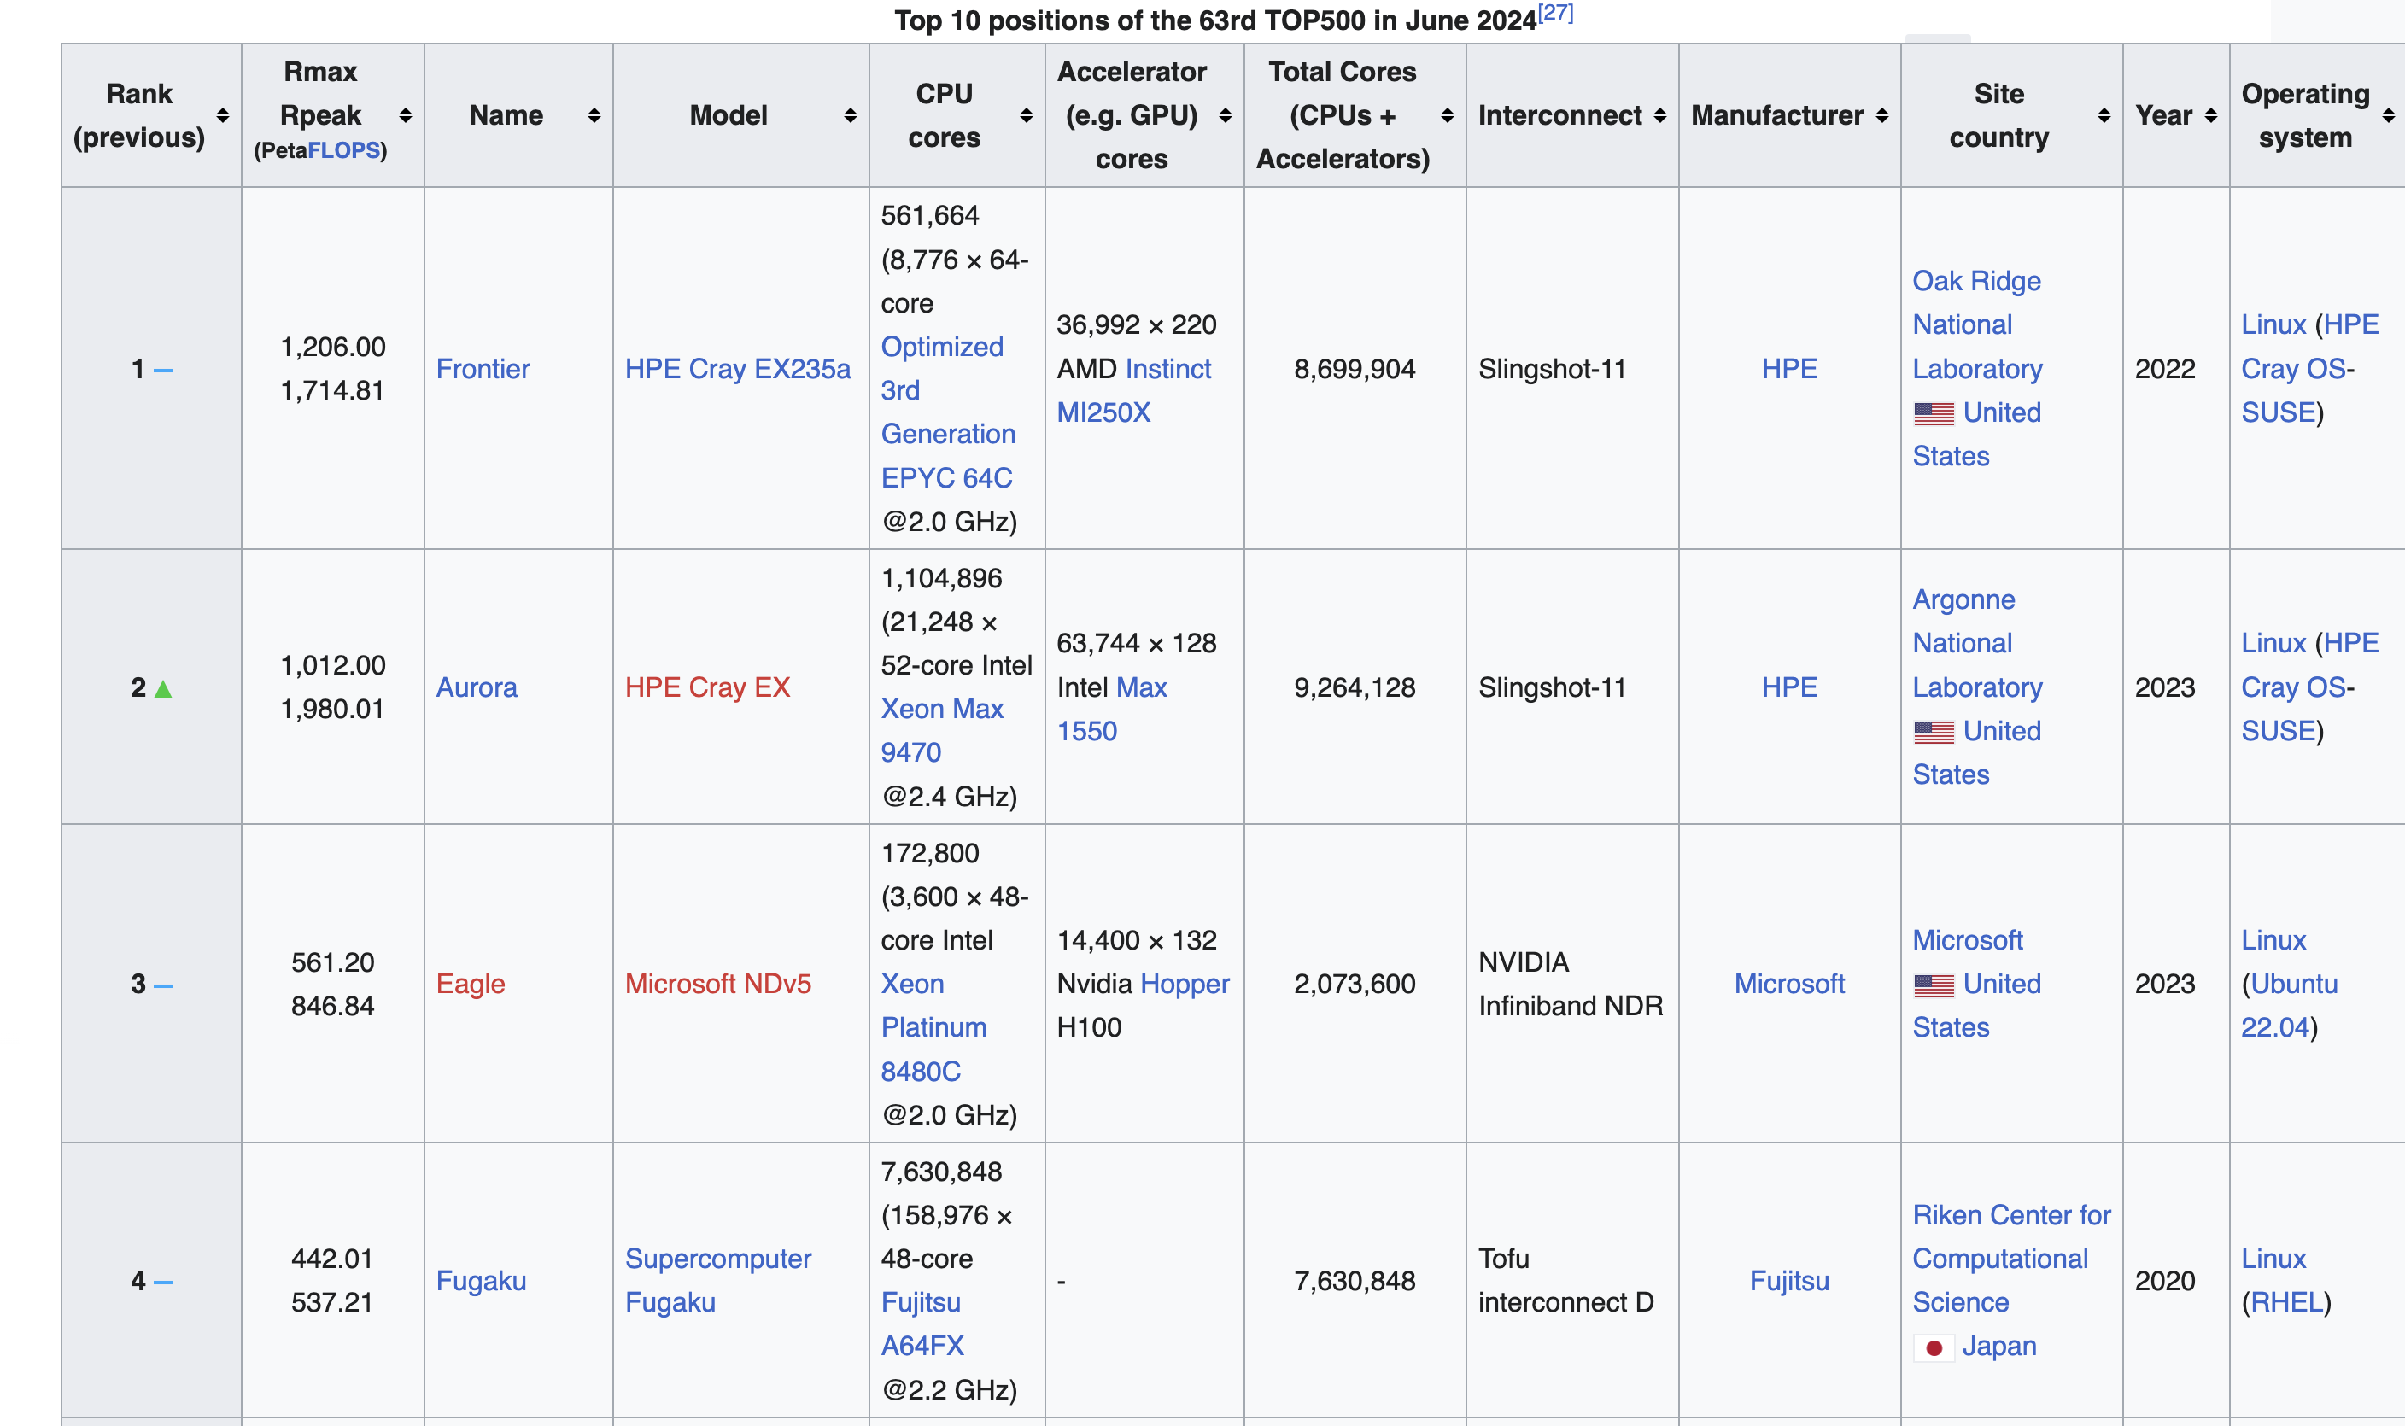

Slide 11
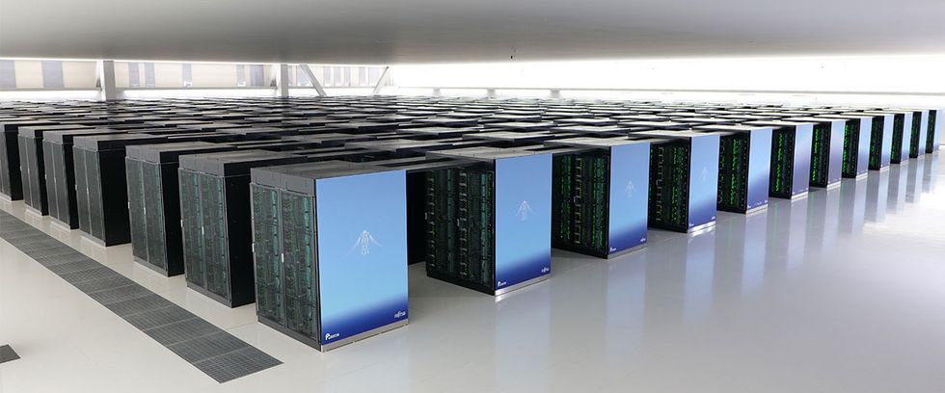
Supercomputing
Fugaku: 7.7M CPUs

Slide 12
Supercomputing
Fugaku: 442 Petaflops

Slide 13
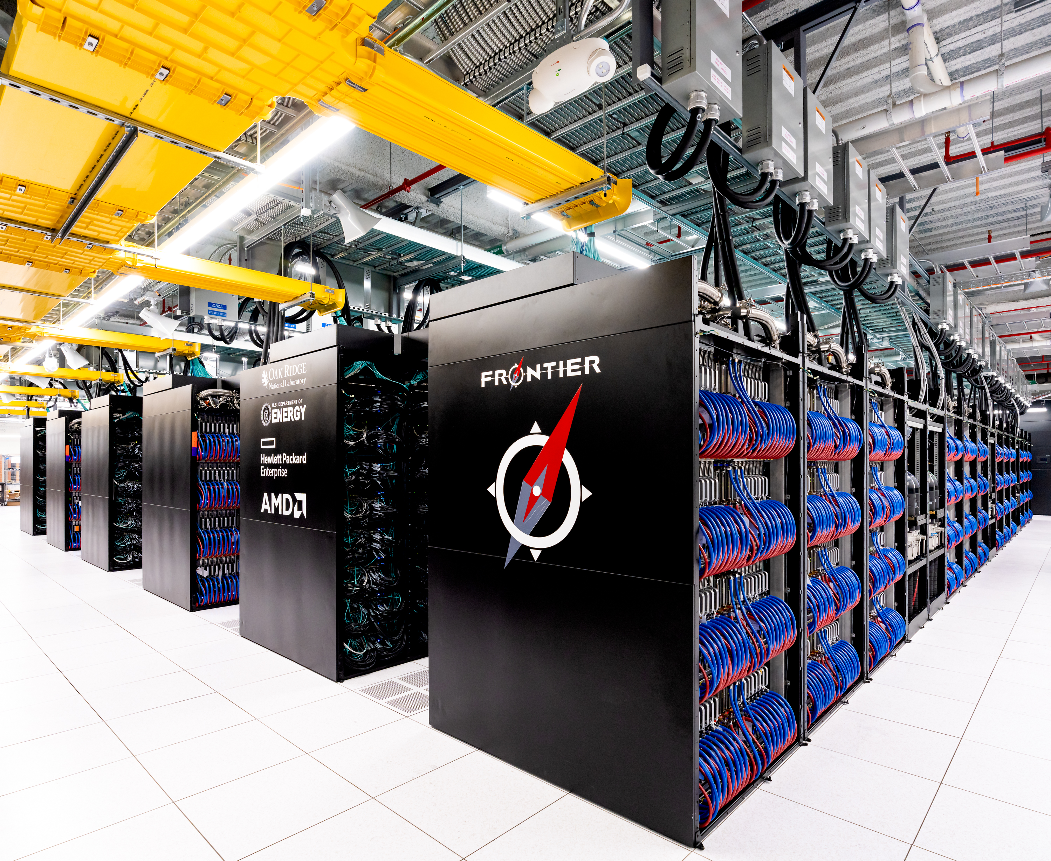
Supercomputing
Frontier:
1.19 Exaflops

Slide 15
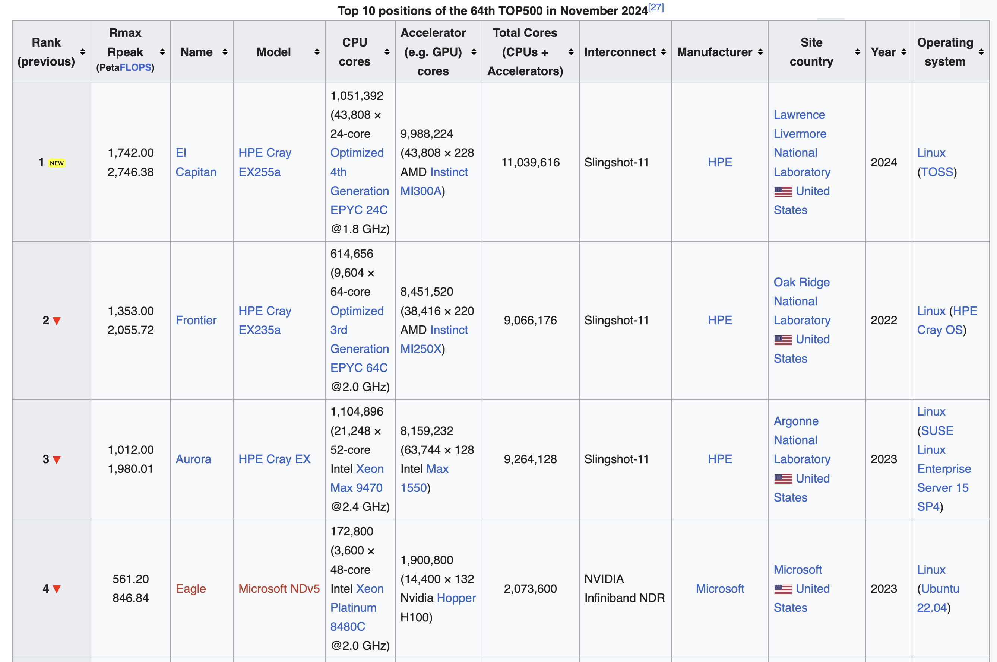
https://en.wikipedia.org/wiki/TOP500

Slide 16
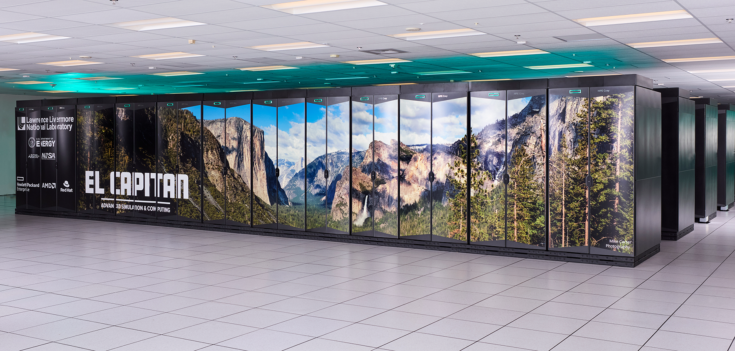

Slide 17


Slide 18
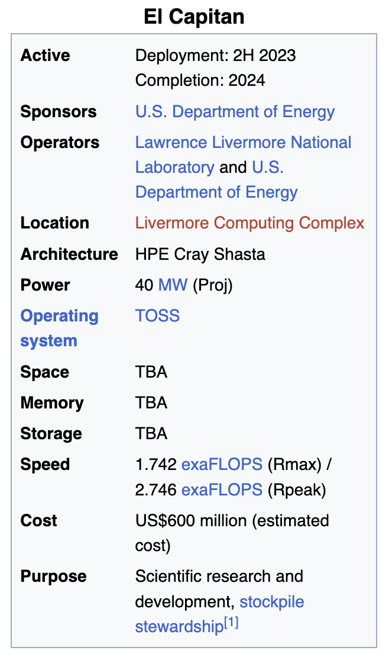

https://en.wikipedia.org/wiki/El_Capitan_(supercomputer)

Slide 19
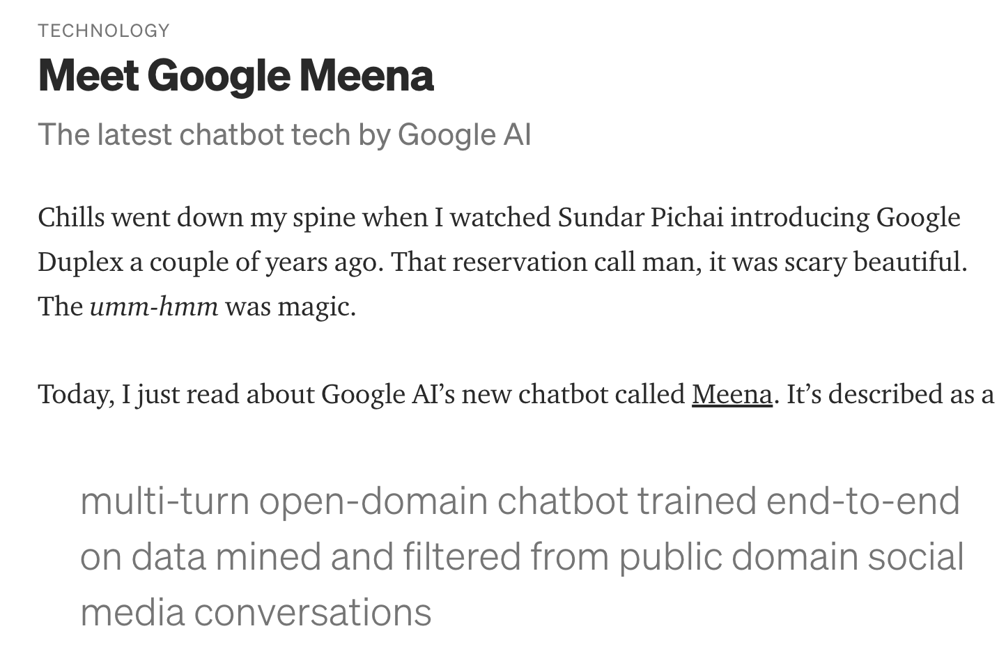

Slide 20
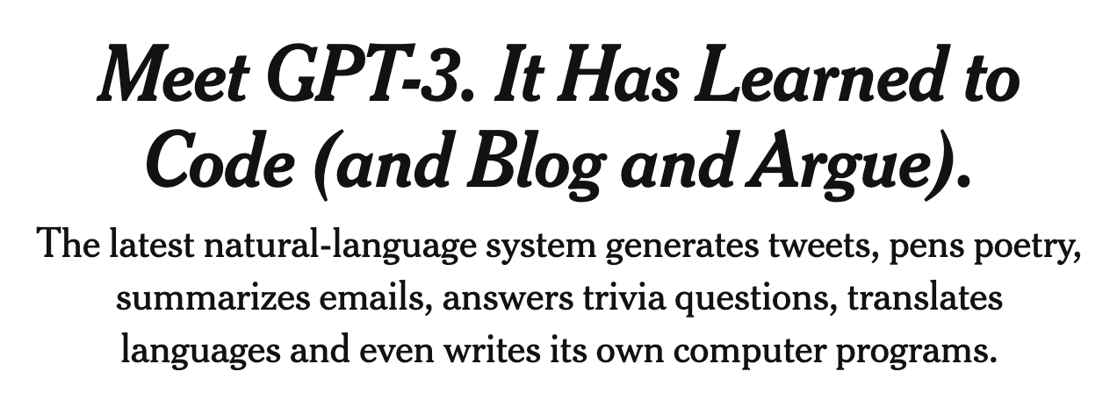
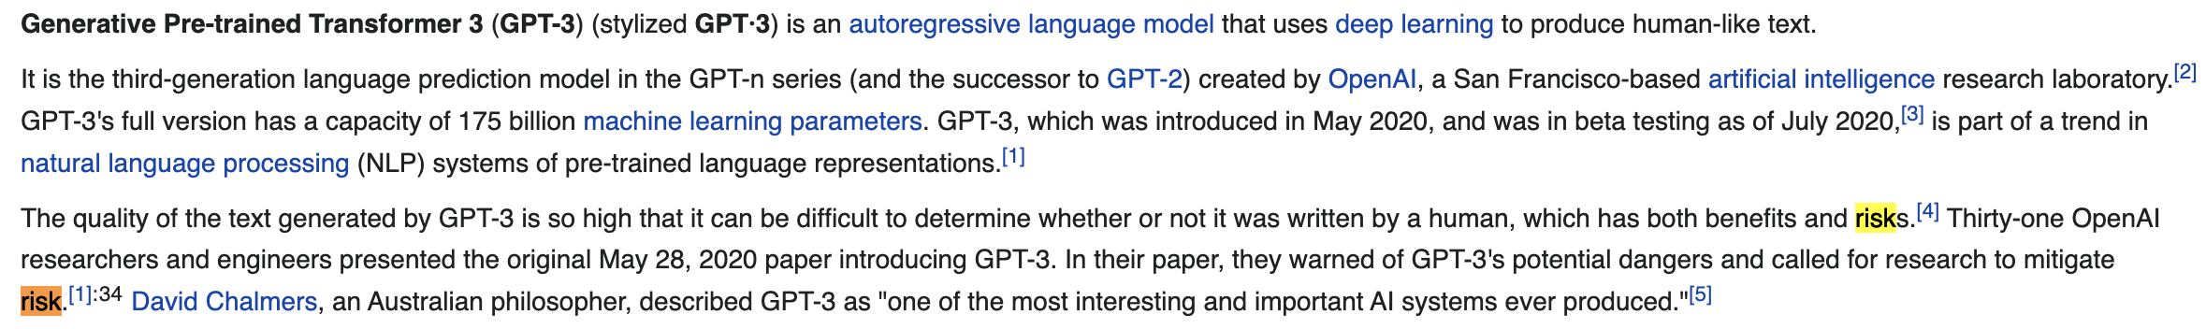


Slide 21
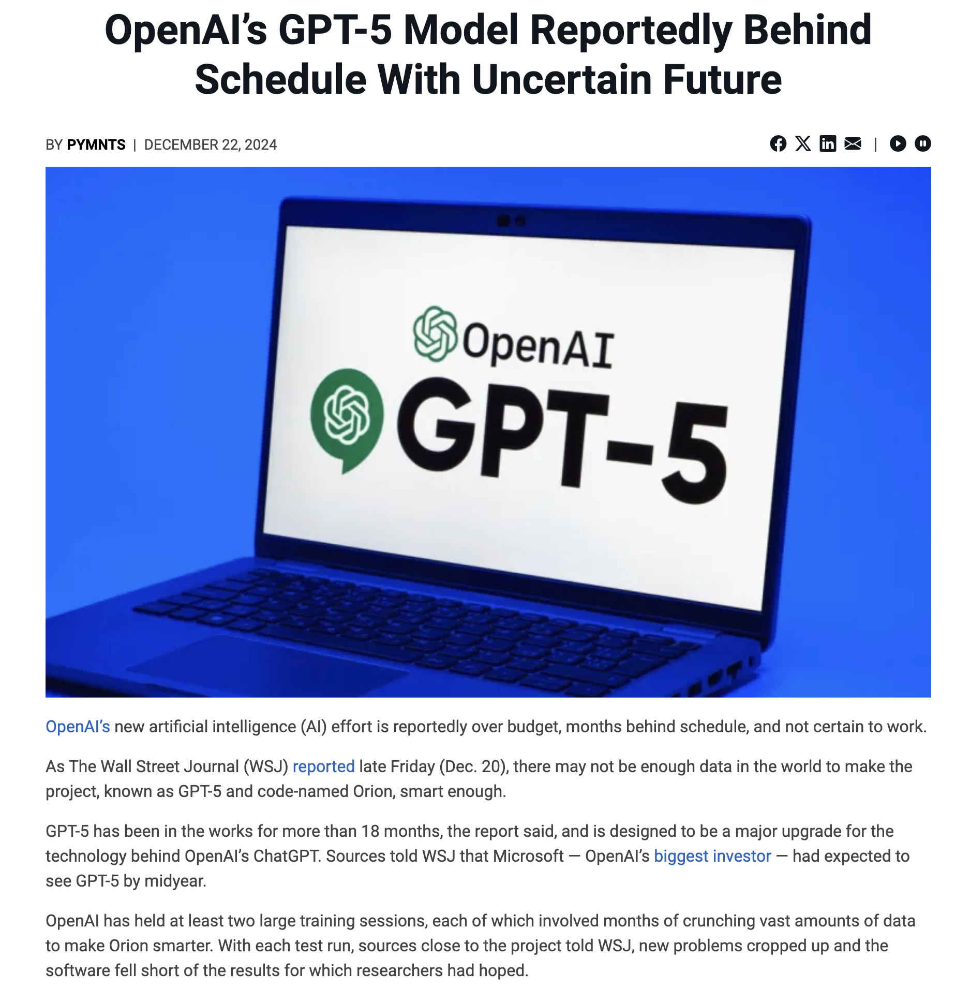
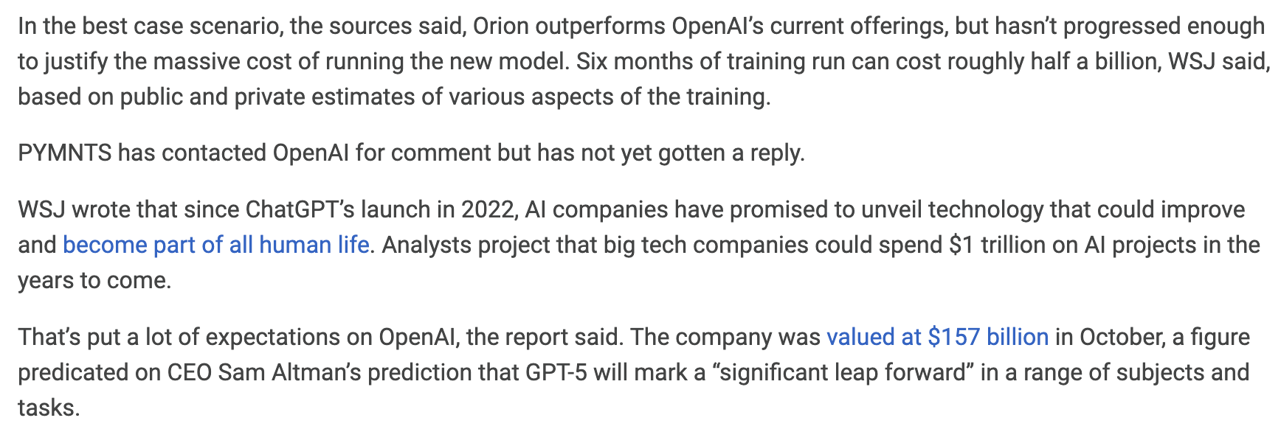
https://www.pymnts.com/artificial-intelligence-2/2024/openais-gpt-5-model-reportedly-behind-schedule-with-uncertain-future/

Slide 22
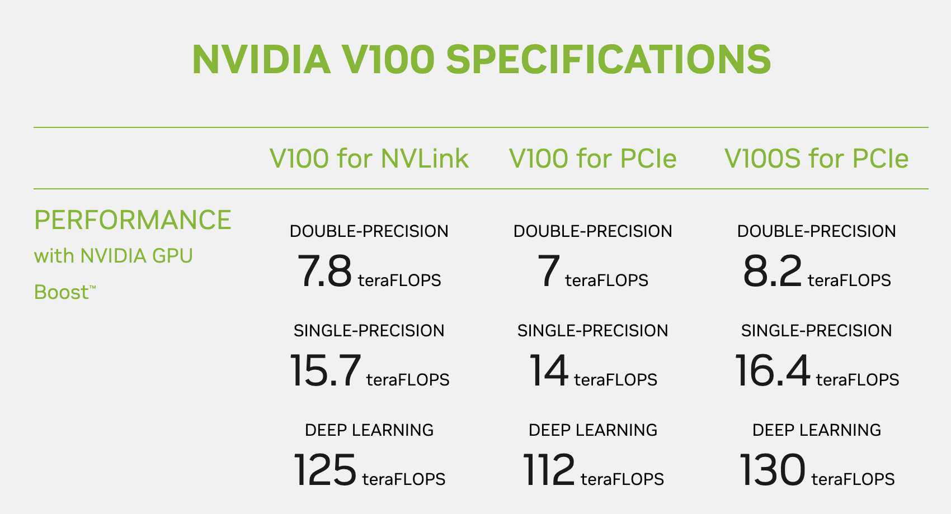

Slide 23
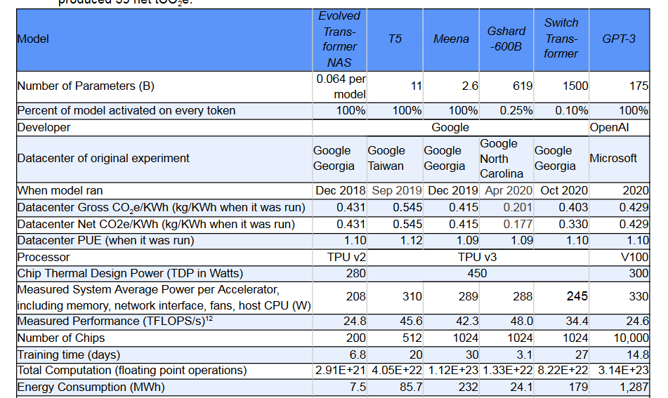
https://www.nvidia.com/en-us/data-center/v100/

Slide 24
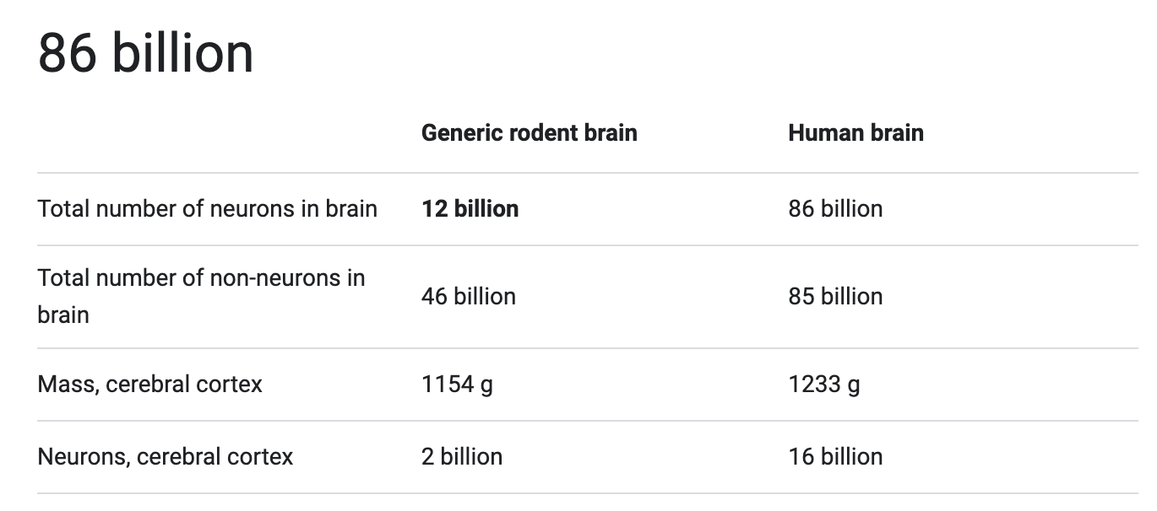
https://www.nvidia.com/en-us/data-center/v100/

Slide 27
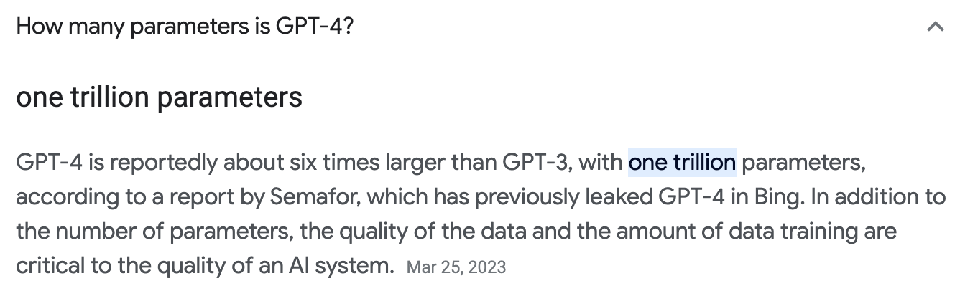

Slide 29
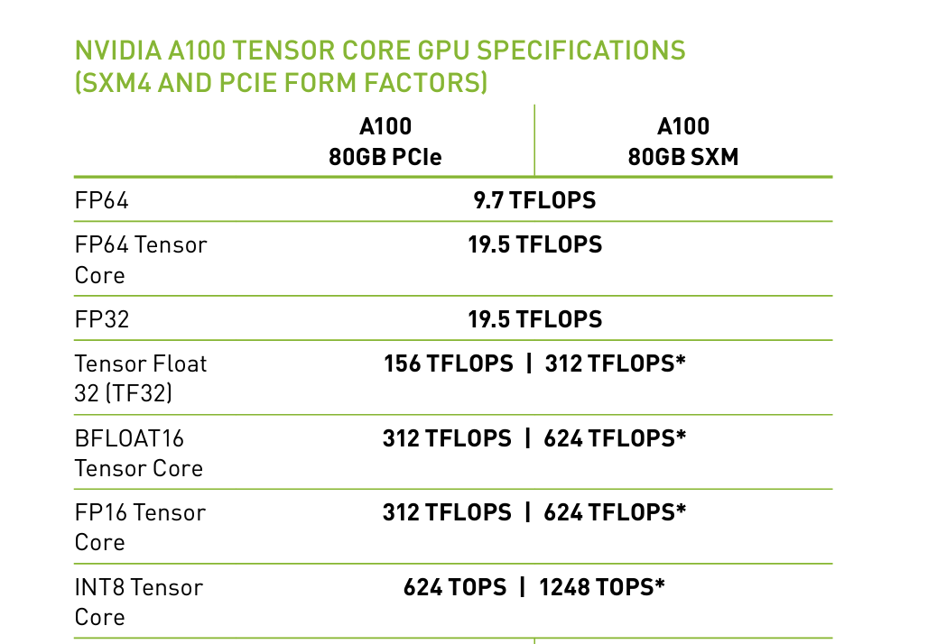

Slide 30
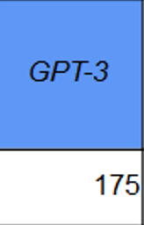

GPT-4
1000
A100
10,000
3 months

Slide 31

https://www.youtube.com/watch?v=EcKQSOnPMoU

Slide 34

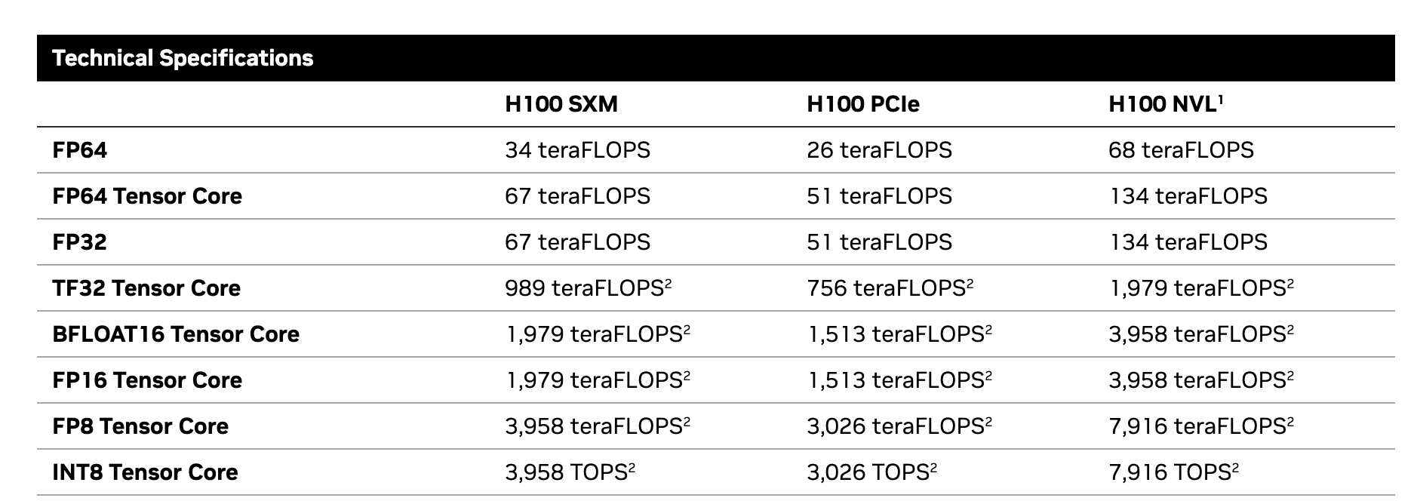
https://resources.nvidia.com/en-us-tensor-core/nvidia-tensor-core-gpu-datasheet

Slide 35

GPT-4
GPT-5
1T
2-5T
A100
H100
10,000
25,000
3 months
4-6 months

Slide 36
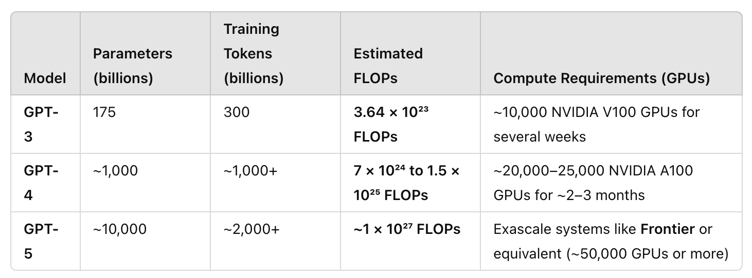

Slide 37
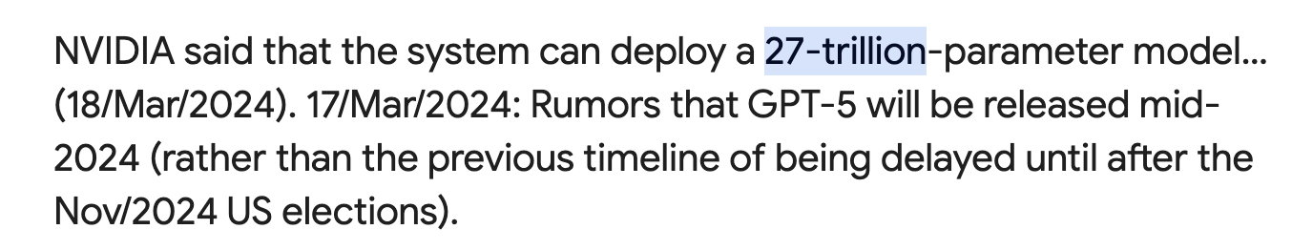

Slide 38
https://www.youtube.com/watch?v=EcKQSOnPMoU

Slide 39
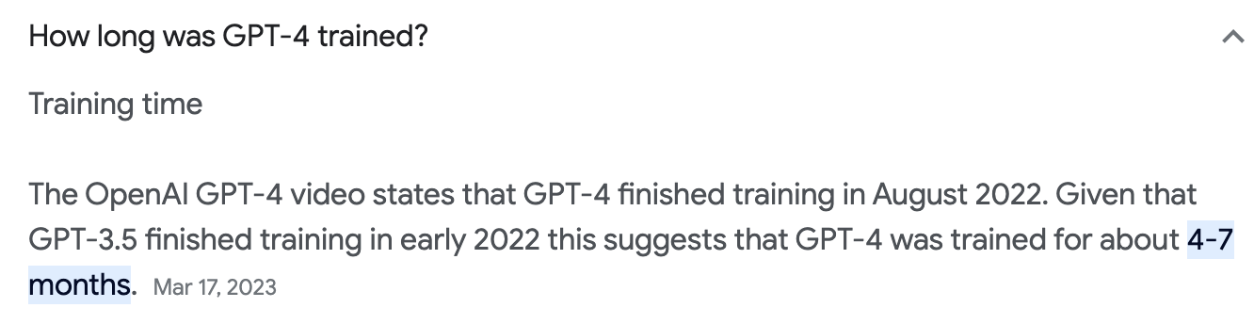
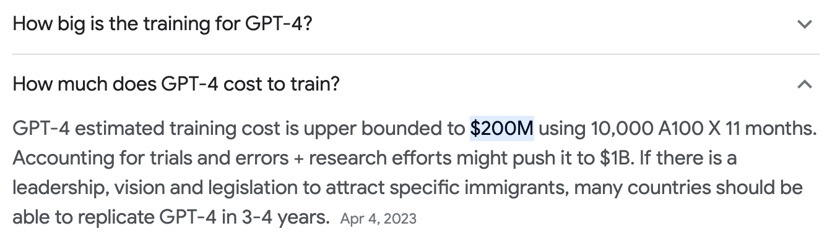
Concerns

Slide 40

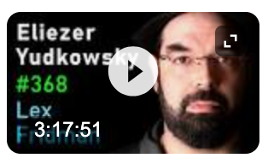
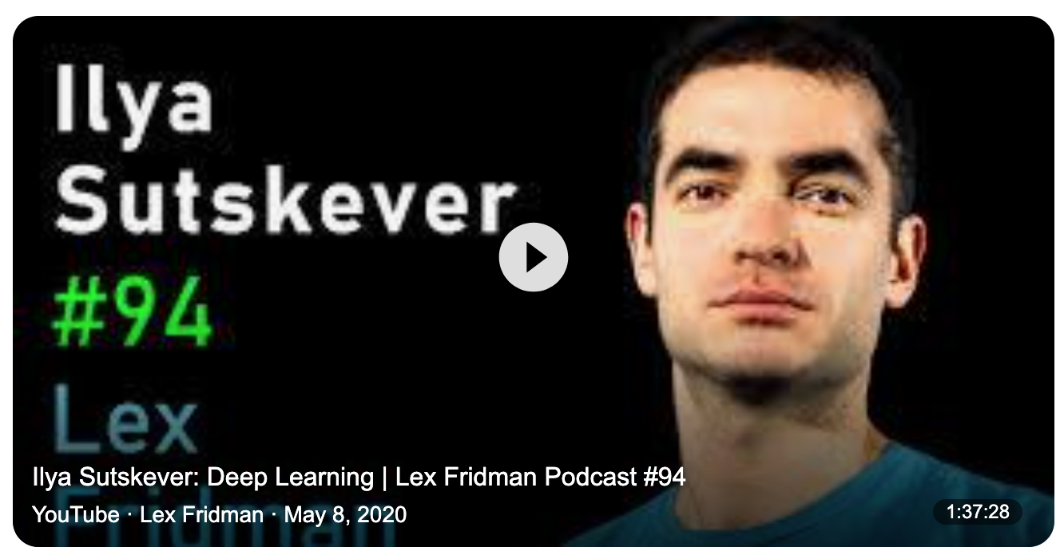
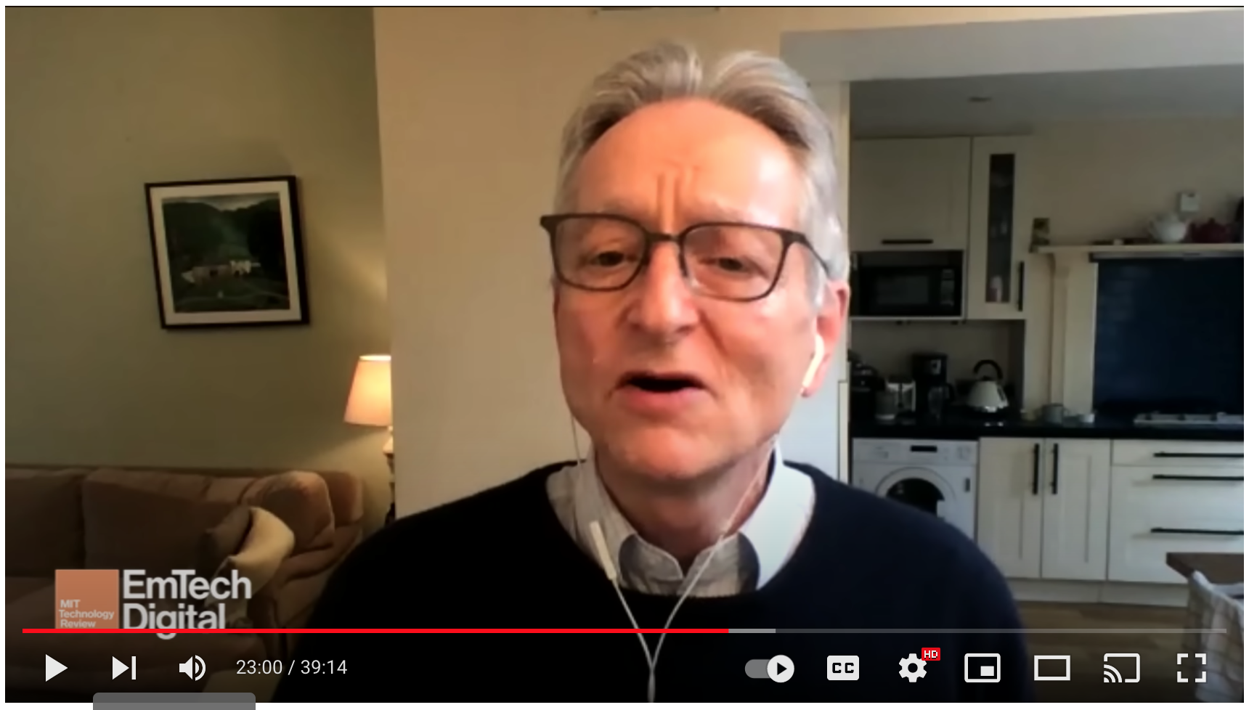
No Shortage of Expert Discussion:
Sam Altman (Open AI CEO)
https://www.youtube.com/watch?v=L_Guz73e6fw
Elizar Yudokowsky(AI Ethics and Philosopher)
https://www.youtube.com/watch?v=L_Guz73e6fw
Ilya Suskever: Lead Developer GPT 3 and 4
https://www.youtube.com/watch?v=13CZPWmke6A
Geoffrey Hinton: Godfather of AI / Formerly Google
https://www.youtube.com/watch?v=sitHS6UDMJc&t=1378s

Slide 41
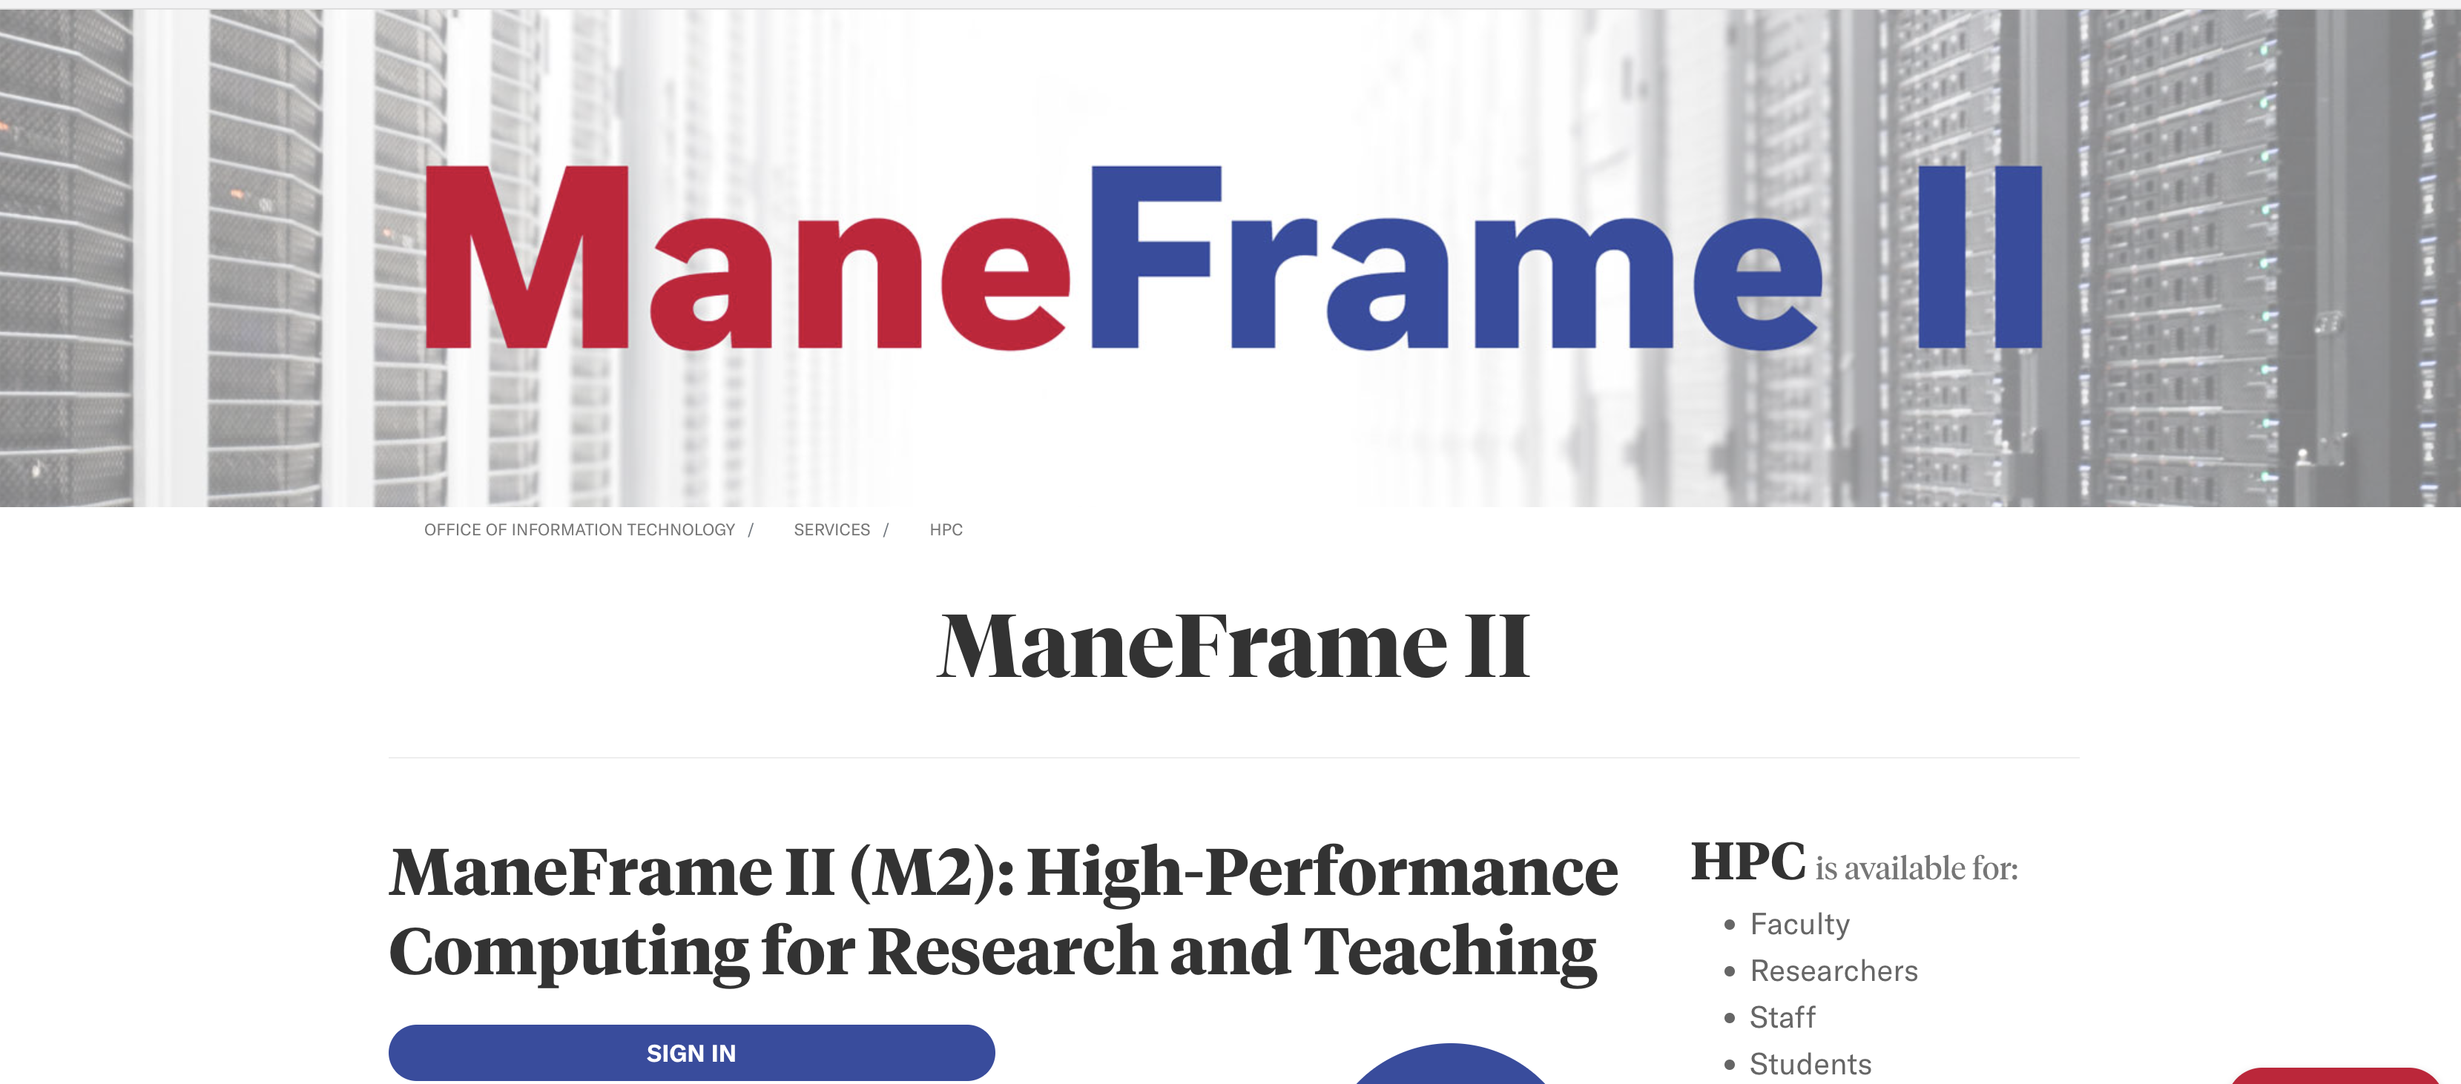
SMU and Super Computing
https://www.smu.edu/OIT/Services/ManeFrame

Slide 42

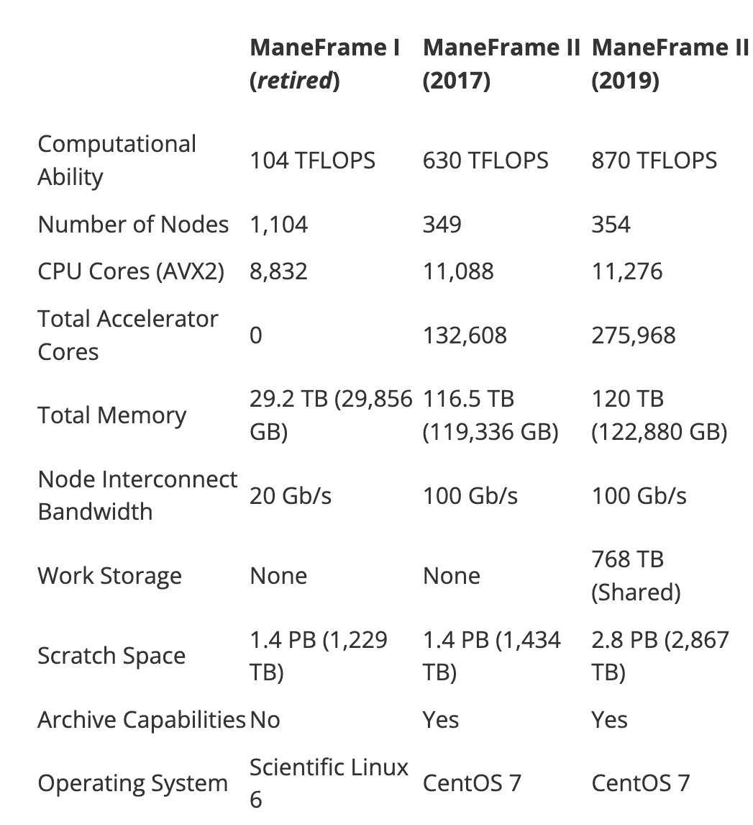
https://blog.smu.edu/itconnect/2022/06/20/new-chapter-hpc-maneframe-iii/
https://s2.smu.edu/hpc/documentation/about.html#accelerator-nodes-with-nvidia-gpus

Slide 43

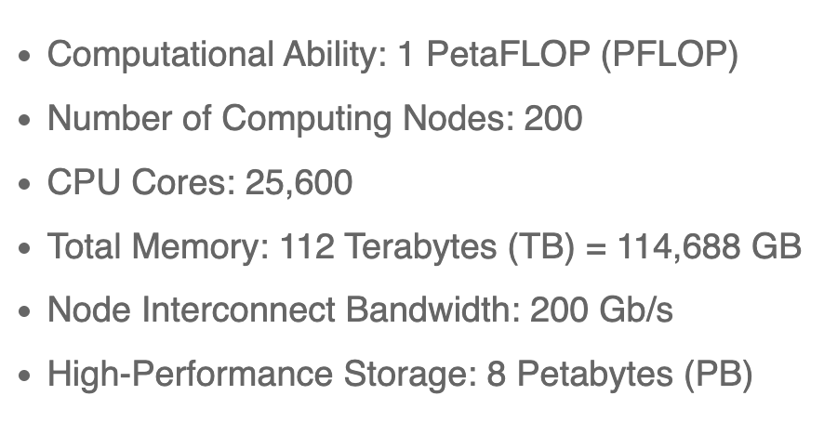
https://blog.smu.edu/itconnect/2022/06/20/new-chapter-hpc-maneframe-iii/

Slide 44
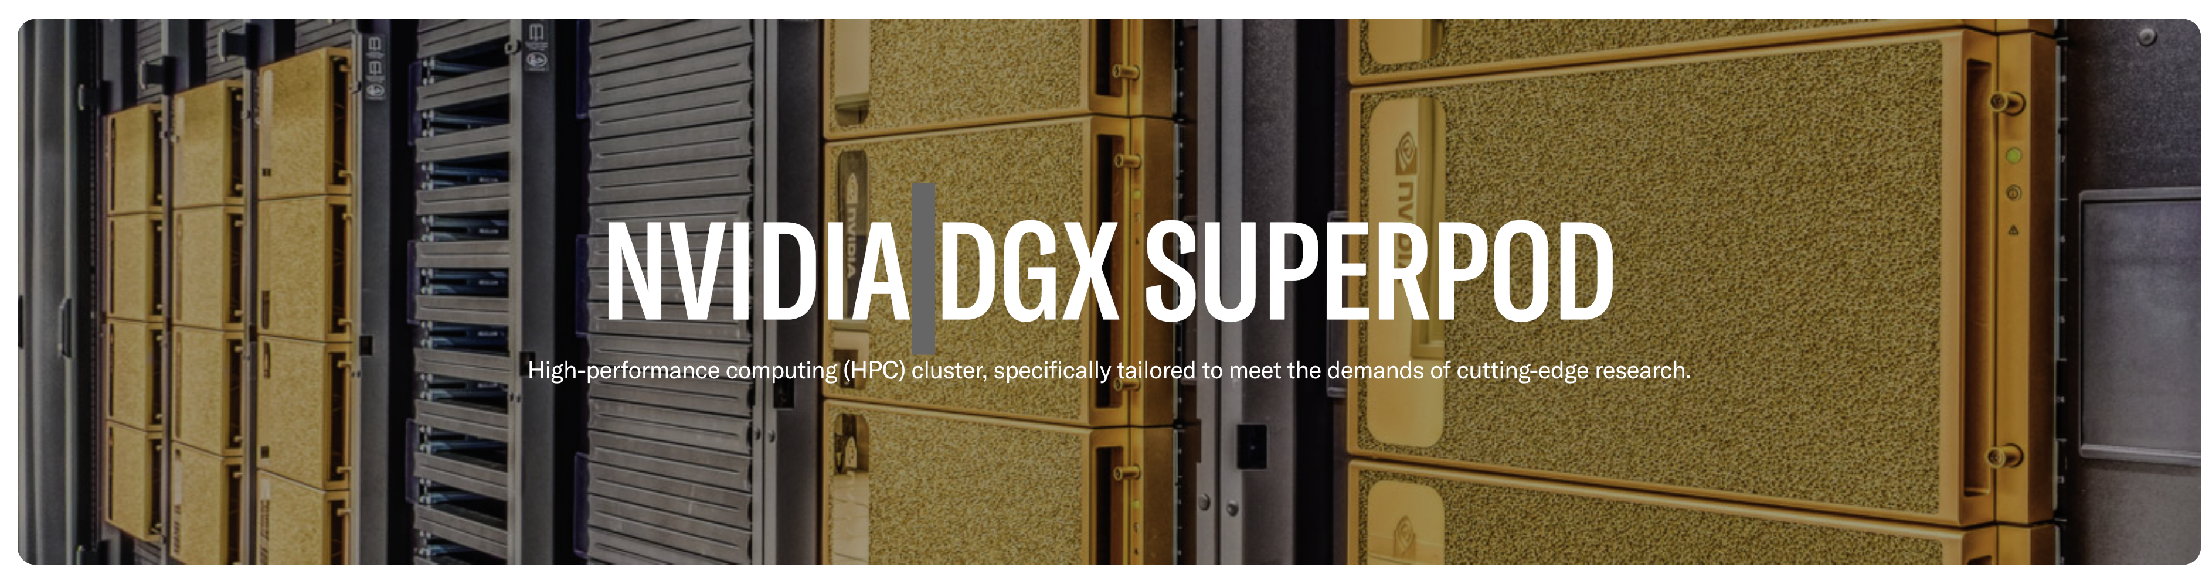
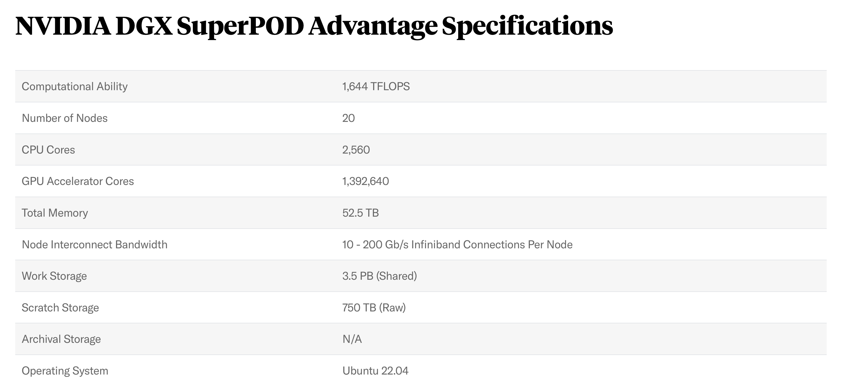
https://www.smu.edu/oit/services/superpod

Slide 45
Conferences!
https://www.hpcwire.com/events/

Slide 46
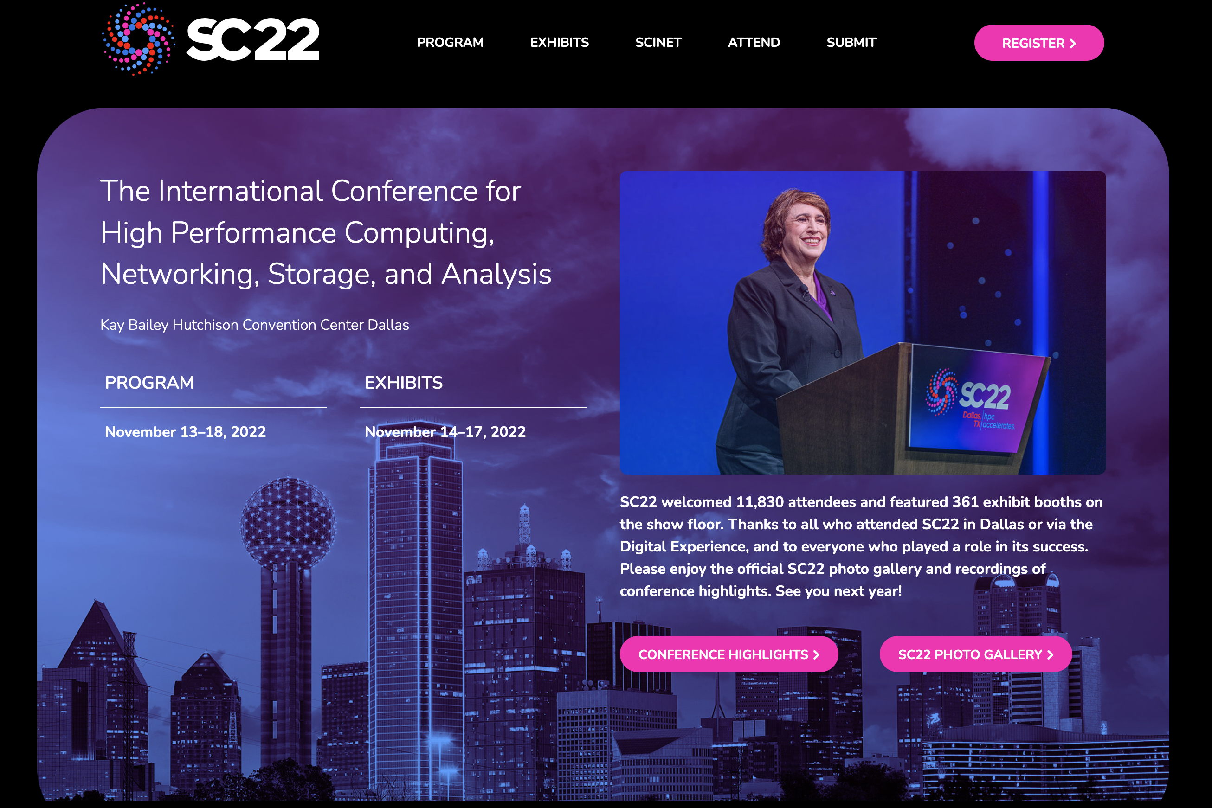

Slide 47
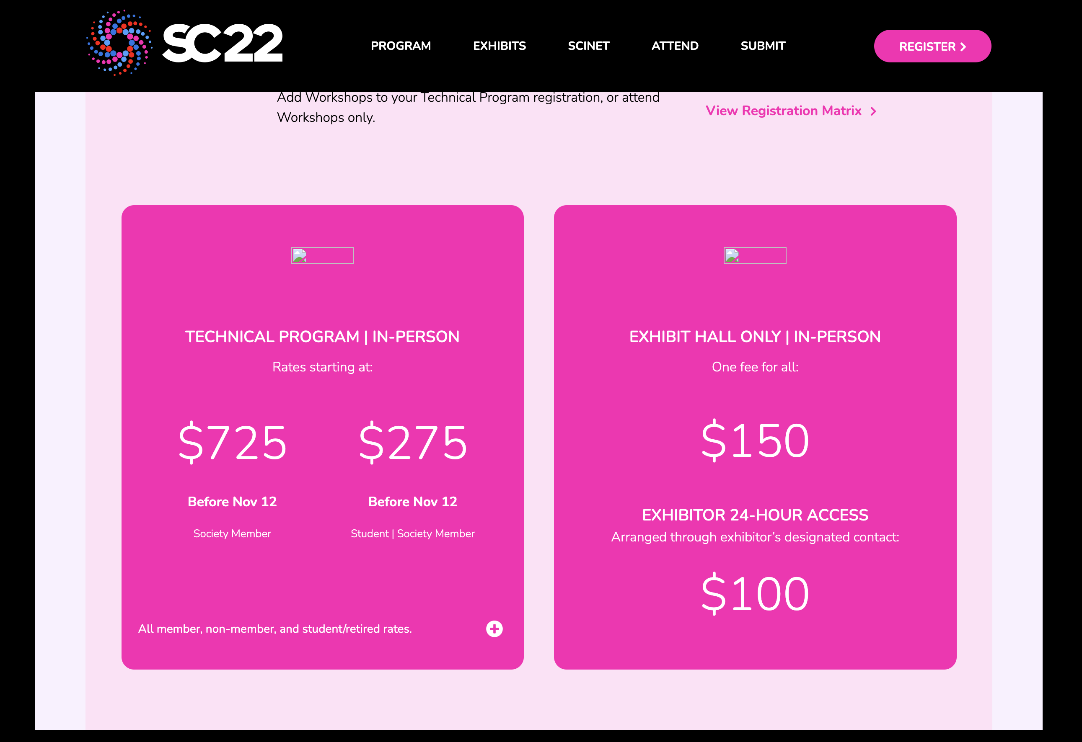
https://sc22.supercomputing.org/attend/registration/

Slide 48
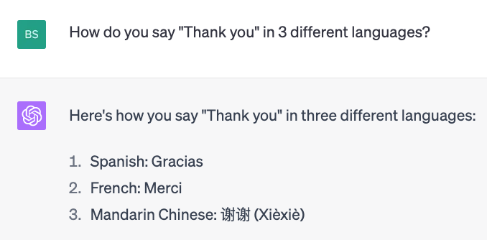
Danke! Do you have any questions?
Bivin Sadler: bsadler@smu.edu

Slide 49
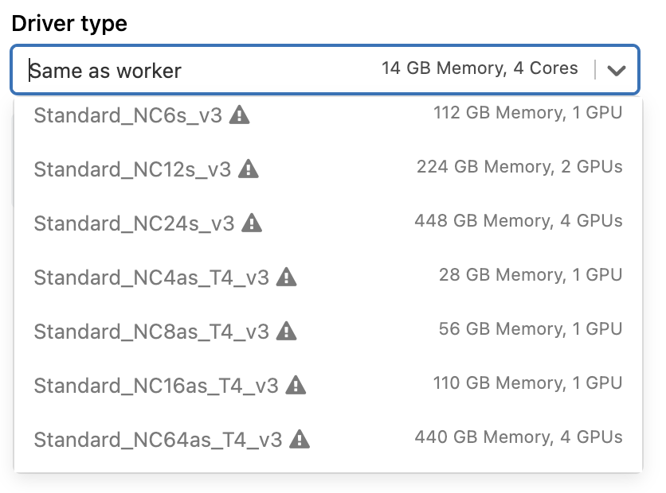
Azure

Slide 50
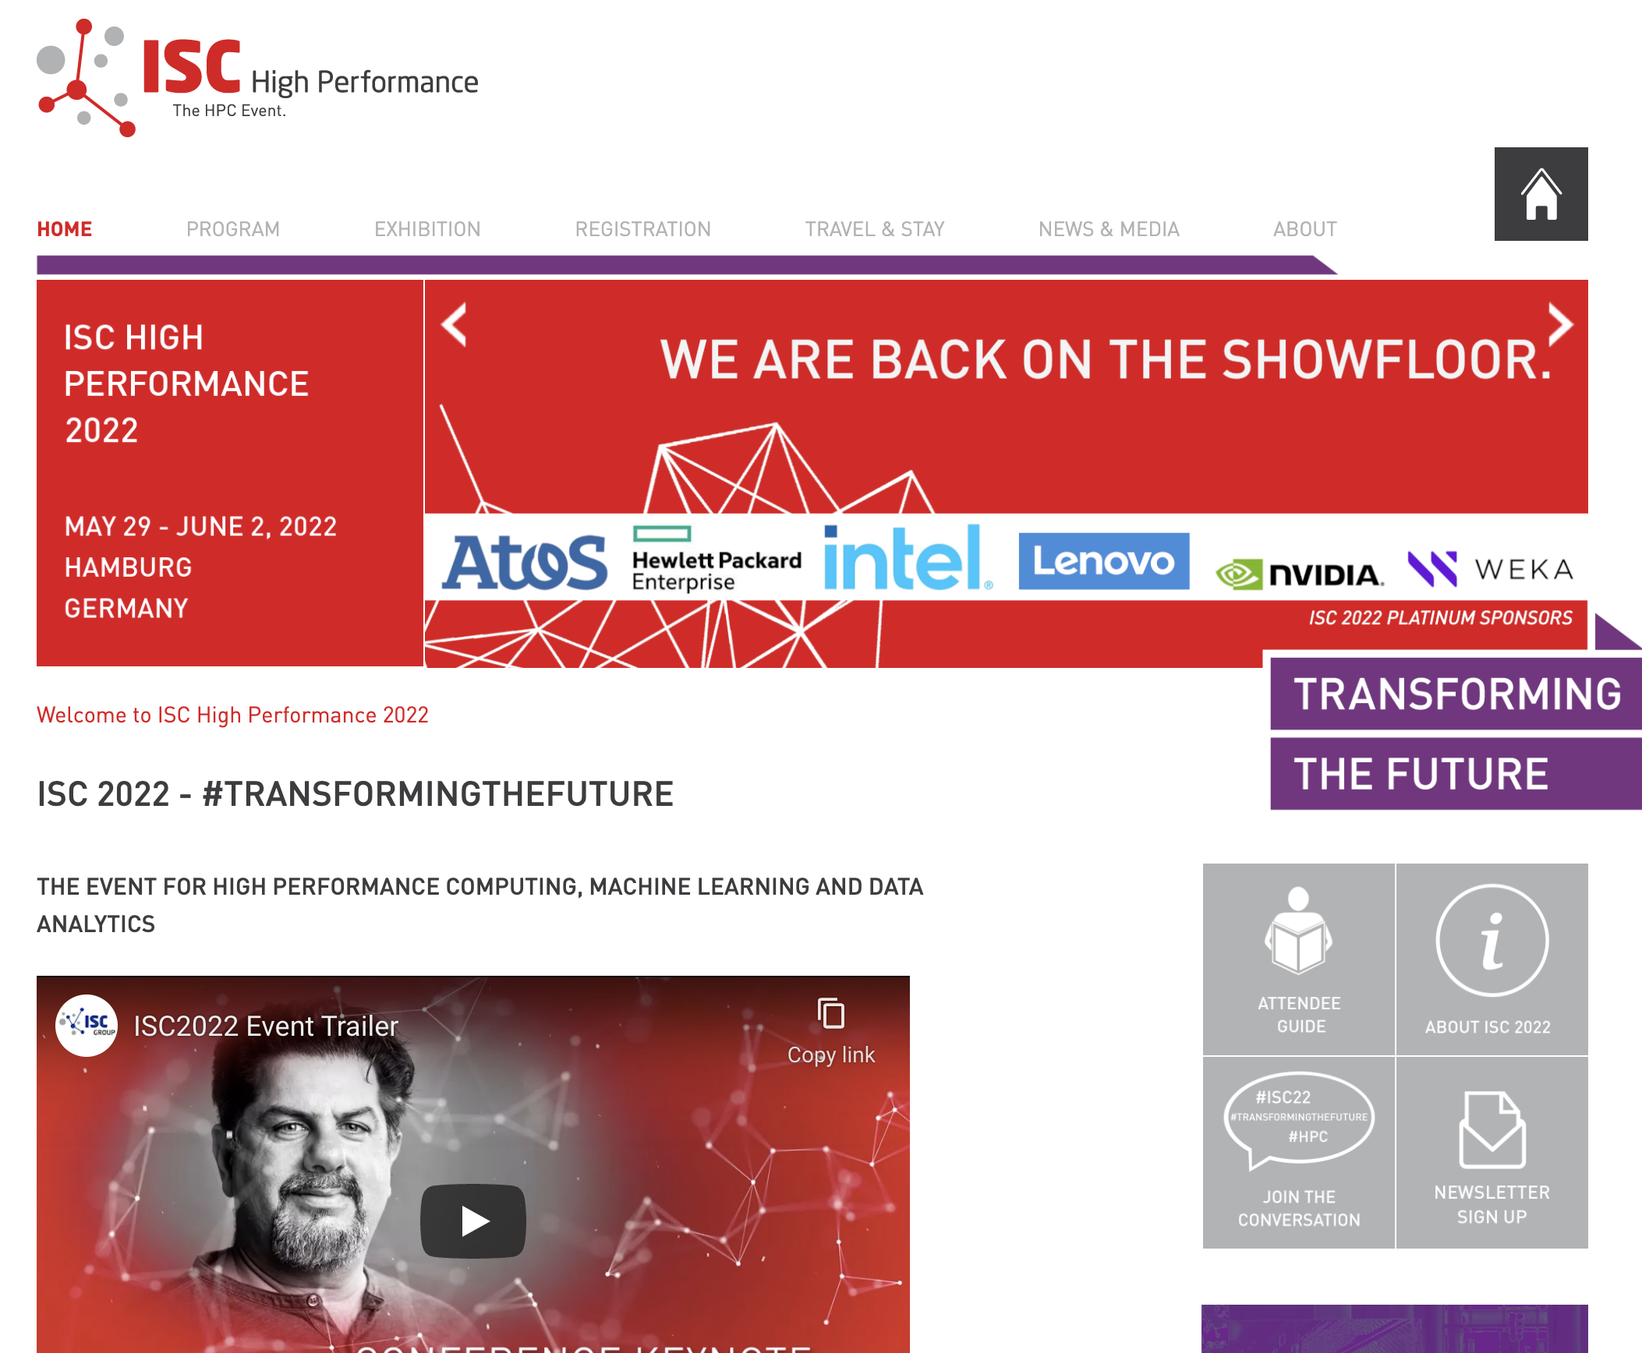
International Super Computing Conference

Slide 51
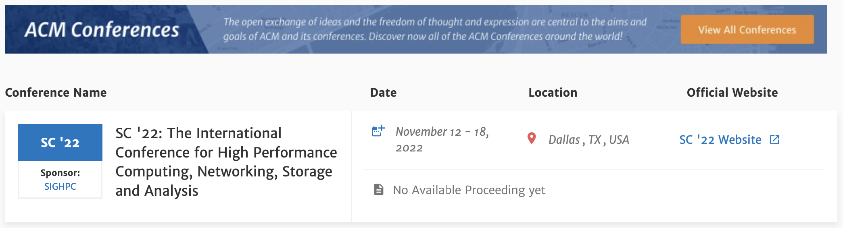
ACM Conference … In Dallas!
https://dl.acm.org/conference/sc/upcoming

